Slide 1
Physical Principles Behind The Workings Of The Universe Austin Rocks
PHYS204 Final Course Project

Slide 2
Introduction pt. 1
Project 1: Gathered and installed required parts and software
Project 2: Test the precision of the ultrasonic sensor, Collect scientific data, and Compute reliable results and draw valid conclusions from data
Project 3: Placed object under sensor and dropped it. Determined the acceleration of an object falling towards the ground
Project 4: Used knowledge I learned about motion to demonstrate the transformation of energy
Project 5: Uploaded the code to the microcontroller with a USB cable, marked my object and rotated it until I reach a full revolution to find number of pulses per rotation, calculated the distance the object of radius rolled through
Project 6:

Slide 3
What tools were used?
Tape measure
Ruler

Slide 4
What were your objectives?
Gathered required inventory for all the experiments.
Download Excel and Arduino on computer
Generate an experiment set up to observe the laws of physics
Test the precision of the ultrasonic sensor
Train in scientific method of observation
Acquire experience handling of electronics equipment
Collect scientific data
Compute reliable results and draw valid conclusions from data
Used knowledge I learned about motion to demonstrate the transformation of energy
Use data from Experiment 3
Paste in excel columns A and B
Enter the final distance of the object in meters from the sensor
Determine mass of the object used in experiment in kg
Generate an experimental set up to observe the laws of physics
Apply the arc length formula to measure linear displacement
Generate an experimental set up to observe the laws of physics
Observe the Hall effect as a relationship between voltage and magnetic

Slide 5
Experiment 1: Inventory of Parts

Slide 6
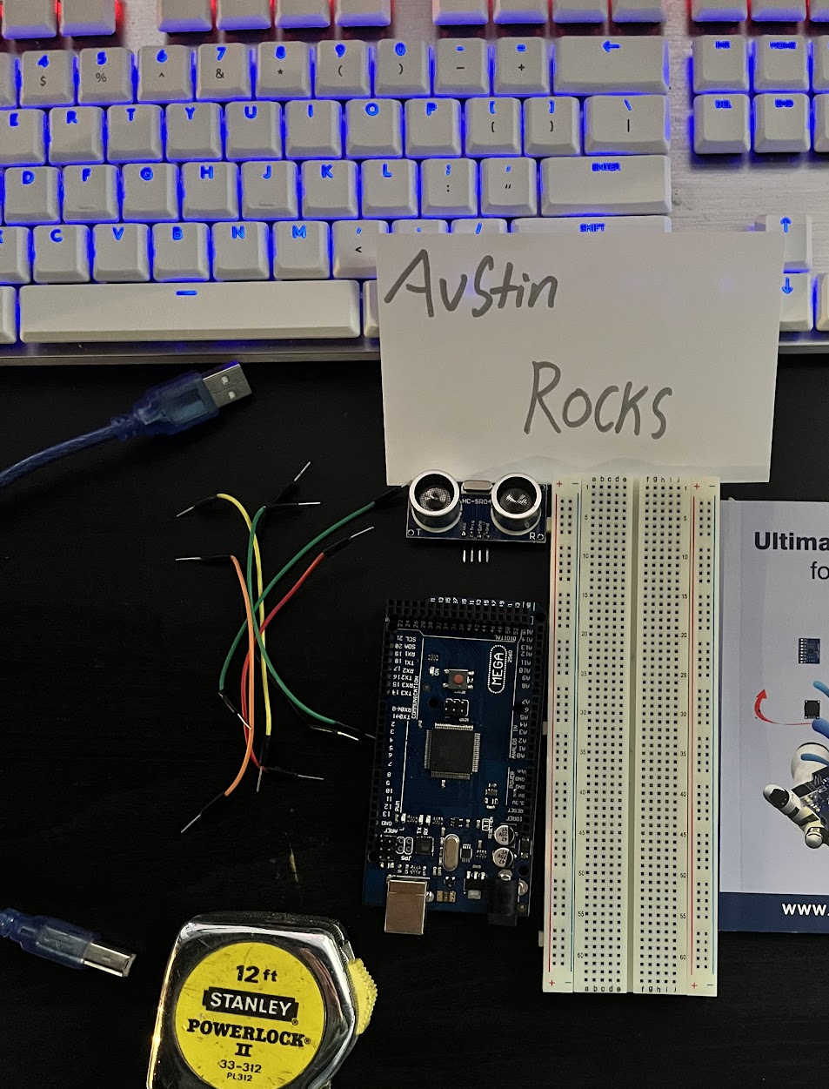
Materials List
Arduino Mega 2560
Ultrasonic sensor HC-SR04
Male to Male Wires
Breadboard
USB cable to connect Arduino
Ruler or tape measurer
Object to act as obstacle and/or undergo free-fall

Slide 7
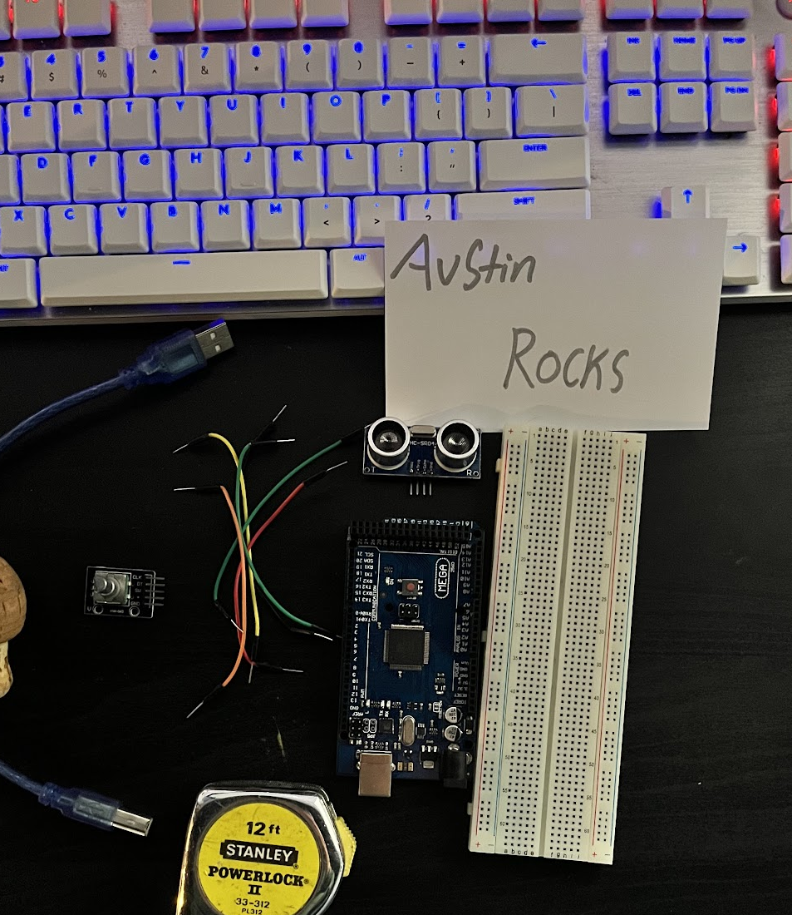
Materials List
Arduino Mega 2560
Rotary Encoder Part KY-040
Male to Female Wires
USB cable to connect Arduino
Object to attach onto rotary encoder
Ruler or tape measurer

Slide 8
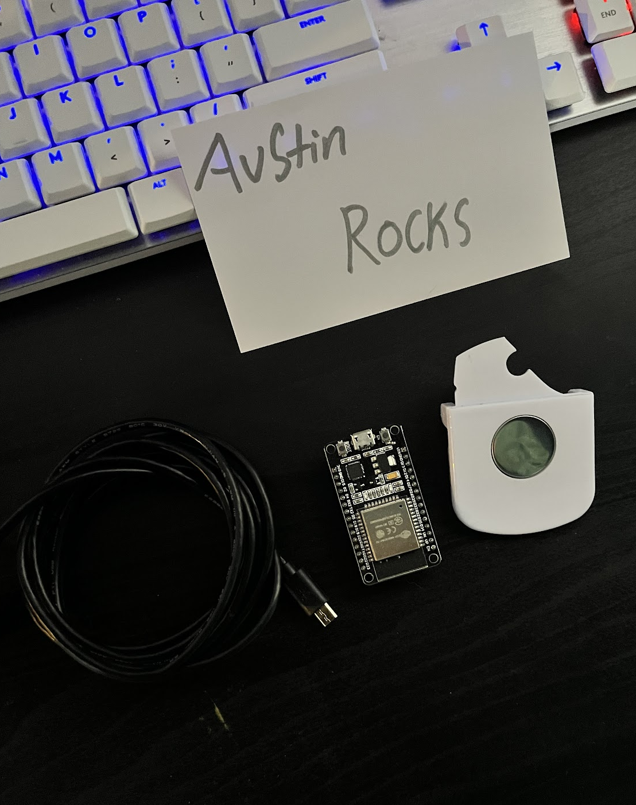
Materials List
ESP32 microprocessor
Micro-USB cable
Magnet

Slide 9
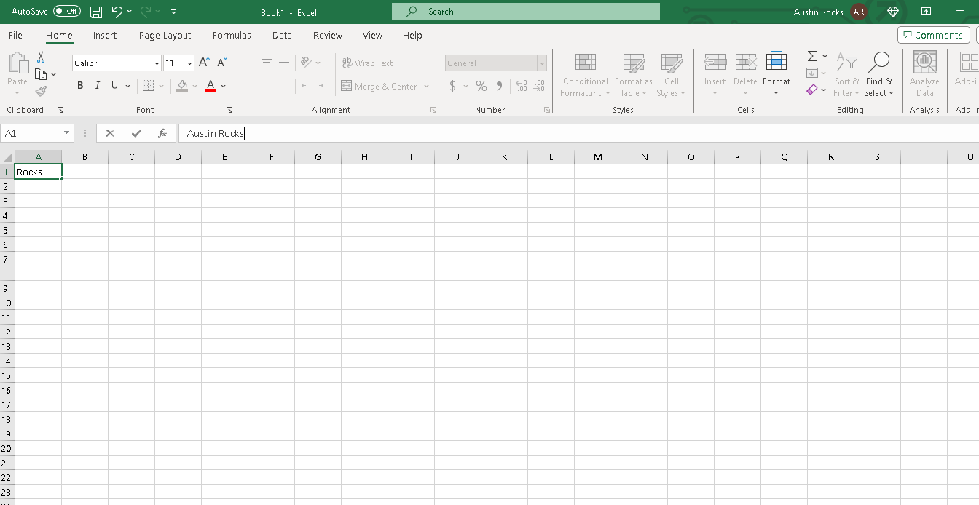
Required Software
Microsoft Excel installed and running

Slide 10
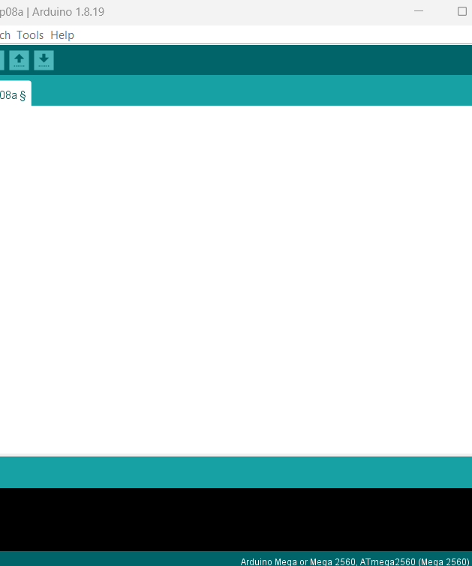
Required Software
Arduino IDE installed and running

Slide 11
Experiment 1: Inventory of Parts Summary
Gathered inventory list
Downloaded required software

Slide 12
Experiment 2: Precision of the Ultrasonic Sensor

Slide 13
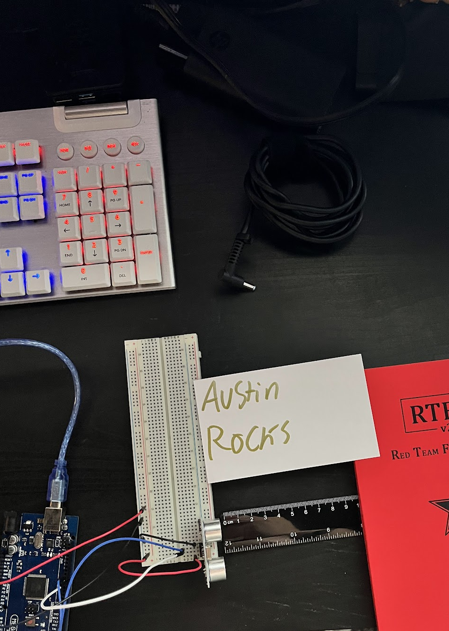
Experimental Set-up
Materials List:
Mega 2560 Board
Ultrasonic sensor HC-SR04
Male to Male Wires
Breadboard
Ruler or tape measurer
Large and flat object to act as obstacle

Slide 14
Setup Ultrasonic Sensor to Mega board
Mount Sensor on breadboard
Vcc connects to 5V from the Mega board
GND connects to GND from the Mega board
Trig pin connects to pin 7 from the Mega board
Echo pin connects to pin 8 from the Mega board

Slide 15
Raw Data
Serial Monitor from Arduino IDE showing raw data.

Slide 16
Data Collection
Trial | Ruler Distance (cm) | Total Roundtrip Distance (m) | Time from Serial Monitor (microseconds) | Roundtrip time (s) | Velocity = distance/time (m/s)
1 | 4 | .08 | 371 | 3.71e-4 | 215
2 | 6 | .12 | 391 | 3.91e-4 | 306
3 | 8 | .16 | 475 | 4.75e-4 | 336
4 | 10 | .20 | 570 | 5.70e-4 | 350
5 | 12 | .24 | 705 | 7.05e-4 | 340

Slide 17
Data Analysis
Average velocity from table
Percent difference where $v_{sound}=343 m/s$
$$v_{avg}= \frac{v_{1}+v_{2}+v_{3}+v_{4}+v_{5}}{5}$$
309
m/s
$$Percent difference = \frac{\left|v_{avg}−v_{sound}\right|}{v_{sound}}×100$$
10.2%
m/s

Slide 18
Conclusions
The results
Based in the results from the project I noticed that the velocity increased as the distance went up.
Source of errors:
When I did the distance on 10 cm, the velocity was higher than the velocity at 12cm. I rechecked my math and the results from the serial monitor and I continued to get the same results.
What is the dependence of temperature, humidity, and atmospheric pressure on the speed of sound? How does it affect the results
Higher temperature and humidity increase the speed of sound and lower temperature and humidity decrease it. It affects the results by influencing how sound travels through air.

Slide 19
Experiment 3: Gravitational Acceleration of a Free-Falling Object

Slide 20
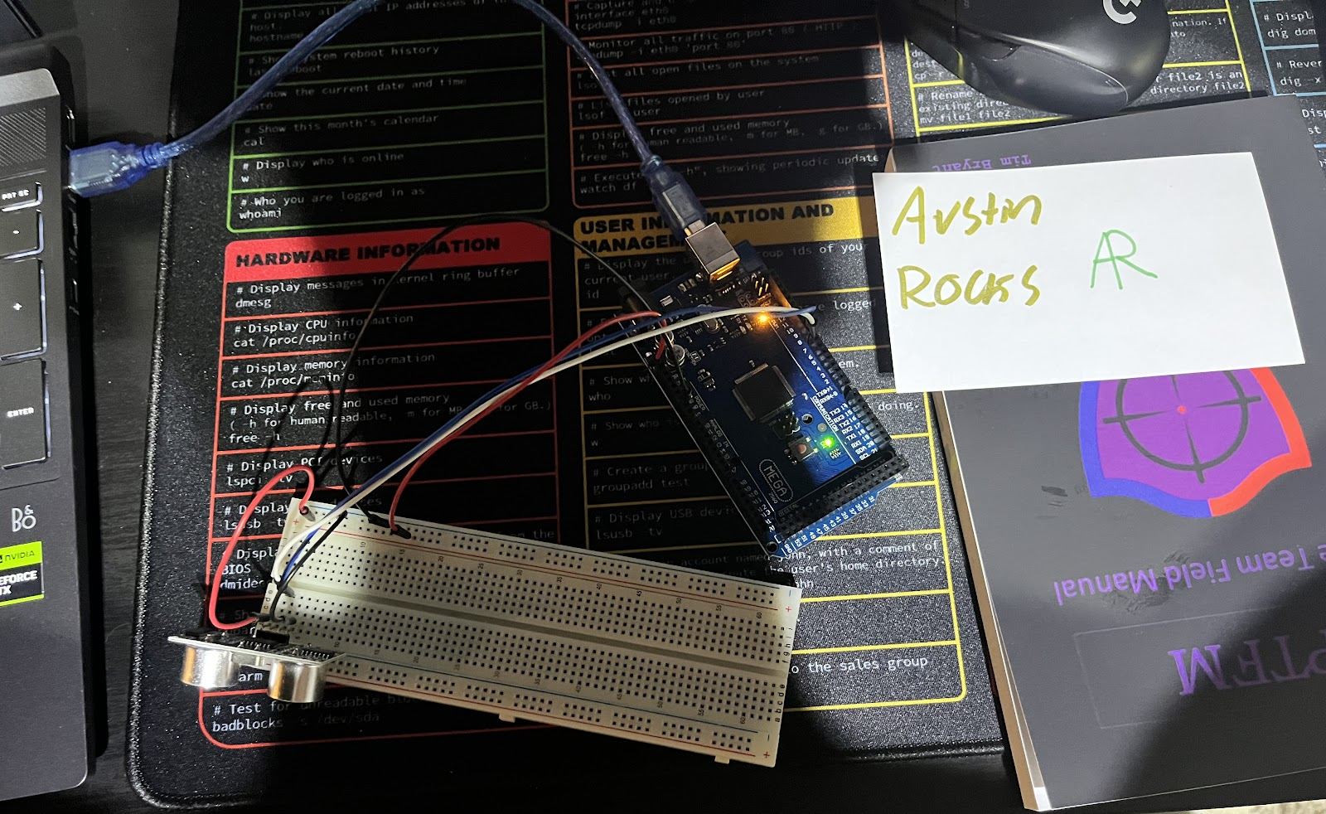
Experimental Set-up
Materials List:
Mega 2560 Board
Ultrasonic sensor HC-SR04
Male to Male Wires
Breadboard
Large and flat object that is not susceptible to air resistance to undergo free fall motion

Slide 21
Experiment Introduction
I applied what I learned about motion as a change of position to find the gravitational acceleration of a free-falling object using the ultrasonic sensor.
Upload the code to the microcontroller with a USB cable.
Place the ultrasonic sensor at the top of a tall surface like a table or kitchen counter facing towards the ground.
Place object under ultrasonic sensor, it will begin to count down from 5, and drop the object carefully
$$y\left(t\right)=\frac{1}{2}at^{2}+v_{0}t+y_{0}$$
I used this formula to determine the acceleration of an object falling towards the ground

Slide 22
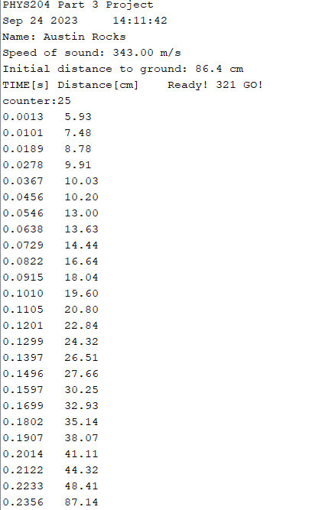
Serial Monitor
Raw data showing the start of the fall and end of the fall of one trial.

Slide 23
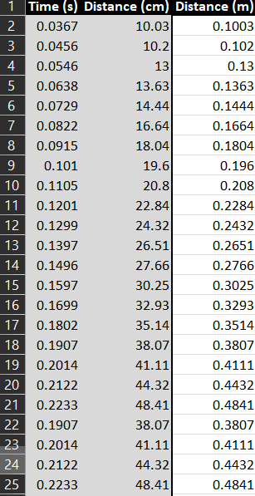
Excel Table
All values in the Excel table from a single trial showing the fall distance in centimeters and meters as a function of time

Slide 24
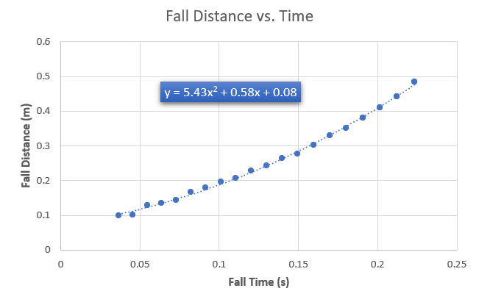
Excel Graph
Single trial showing the fall distance as a function of time.
The x² coefficient should be between 2.5 and 7.5 such that its yields an acceleration value between 5 m/s² and 15 m/s²

Slide 25
Data Collection
Trial | x² coefficient value from curve fitting | Acceleration (m/s²) = 2* (x² coefficient)
1 | 5.43 | 10.86
2 | 5.01 | 10.02
3 | 6.44 | 12.88
4 | 5.82 | 11.64
5 | 3.08 | 6.16

Slide 26
Data Analysis
Average acceleration from table
Percent difference with $g=9.8 m/s^{2}$
$$a_{avg}= \frac{a_{1}+a_{2}+a_{3}+a_{4}+a_{5}}{5}$$
10.31
m/s
$$Percent difference =\frac{\left|a_{avg}−g\right|}{g}×100$$
5.22
m/s

Slide 27
Conclusions
The results and the sources of error.
The overall acceleration from the trials were very similar. I did notice during the trials if my hand slightly affected the angle of the drop, the results would be very different from a normal trial. Instead of a large range of output, I would only get about 4 pieces of data from the trial.
How much variation is there from trial to trial? What does this indicate about the uncertainty of the result?
I was surprised by the variations throughout the trials. Most of the trials were very similar but the final trial was drastically different from the others even though I tried to keep everything the same.

Slide 28
Experiment 3 Summary
Upload code to microcontroller
Placed object under sensor and dropped it
$$y\left(t\right)=\frac{1}{2}at^{2}+v_{0}t+y_{0}$$
I used this formula to determine the acceleration of an object falling towards the ground

Slide 29
Experiment 4:Conservation of Energy of a Free-Falling Object

Slide 30
Analysis Set-Up
Paste the data from experiment 3 into columns A and B into the Excel file provided.
Enter Final distance of the object in meters
Determine mass of an object used in the experiment
$$m=\frac{weight}{g}$$

Slide 31
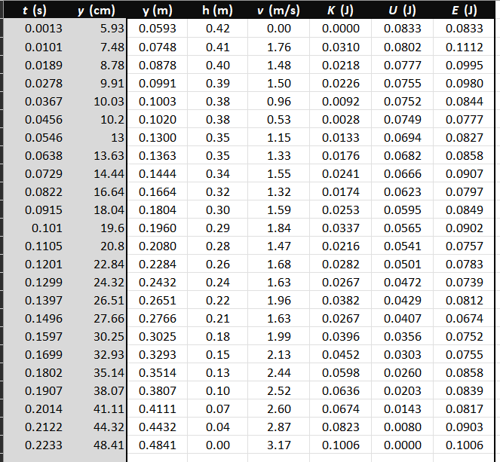
Excel Table
All values in the Excel table for a single trial showing the fall distance in centimeters and meters as a function of time with the values generated for kinetic energy K, potential energy U, and total mechanical energy E.

Slide 32
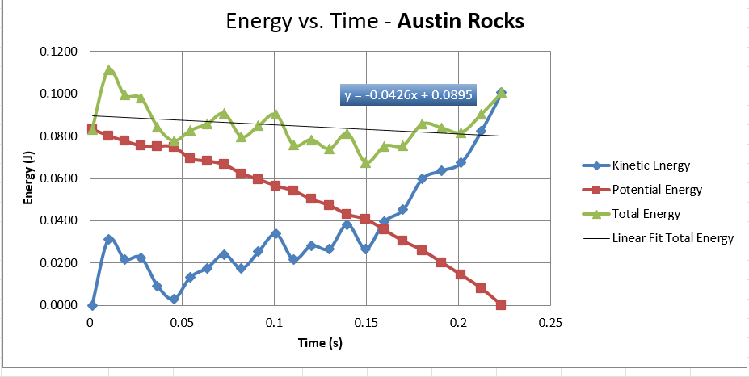
Excel Graph
Include Excel graph for a single trial showing the plots of the kinetic energy K, potential energy U, and total mechanical energy E as a function of time.

Slide 33
Data Analysis
Theoretical value of final velocity
Final velocity from experimental data (or largest velocity)
Percent difference
$h=y_{final}−y_{initial}=$
0.4841-0.0593
0.4248 m
$v_{f}=\sqrt{2gh}=$
$$\sqrt{2∗9.8∗.4248}$$
2.89 m/s
$v_{experimental}$ =
3.17
m/s
$$Percent difference =\frac{\left|v_{f}−v_{experimental}\right|}{v_{f}}×100$$
9.69%

Slide 34
Conclusions
Discuss the key characteristics of the plot. Consider the points when potential energy U is maximum, U is minimum, kinetic energy K is maximum, K is minimum and when U and K are the same value. What is the significance of these points?
When one is at the maximum the other is at its minimum for both kinetic and potential Energy. When the two are the same value and cross paths, it’s called the equilibrium.

Slide 35
Conclusions
What is the trend of the best fit line for the total energy E in your data? If the data is accurate, the total mechanical energy should decrease slightly. Why is that?
My experiment isn’t completely accurate; It was decreasing but spiked at the end. The total energy began decreasing but spike at the last second. It should decrease because of air resistance; rotation could also be a factor in the decrease in of the mechanical energy.

Slide 36
Experiment 4 Summary
Used data from experiment 3
Pasted data into Excel
Created a chart showing the different energies
Calculated Theoretical value of final velocity
Calculated Final velocity from experimental data
Calculated percent difference

Slide 37
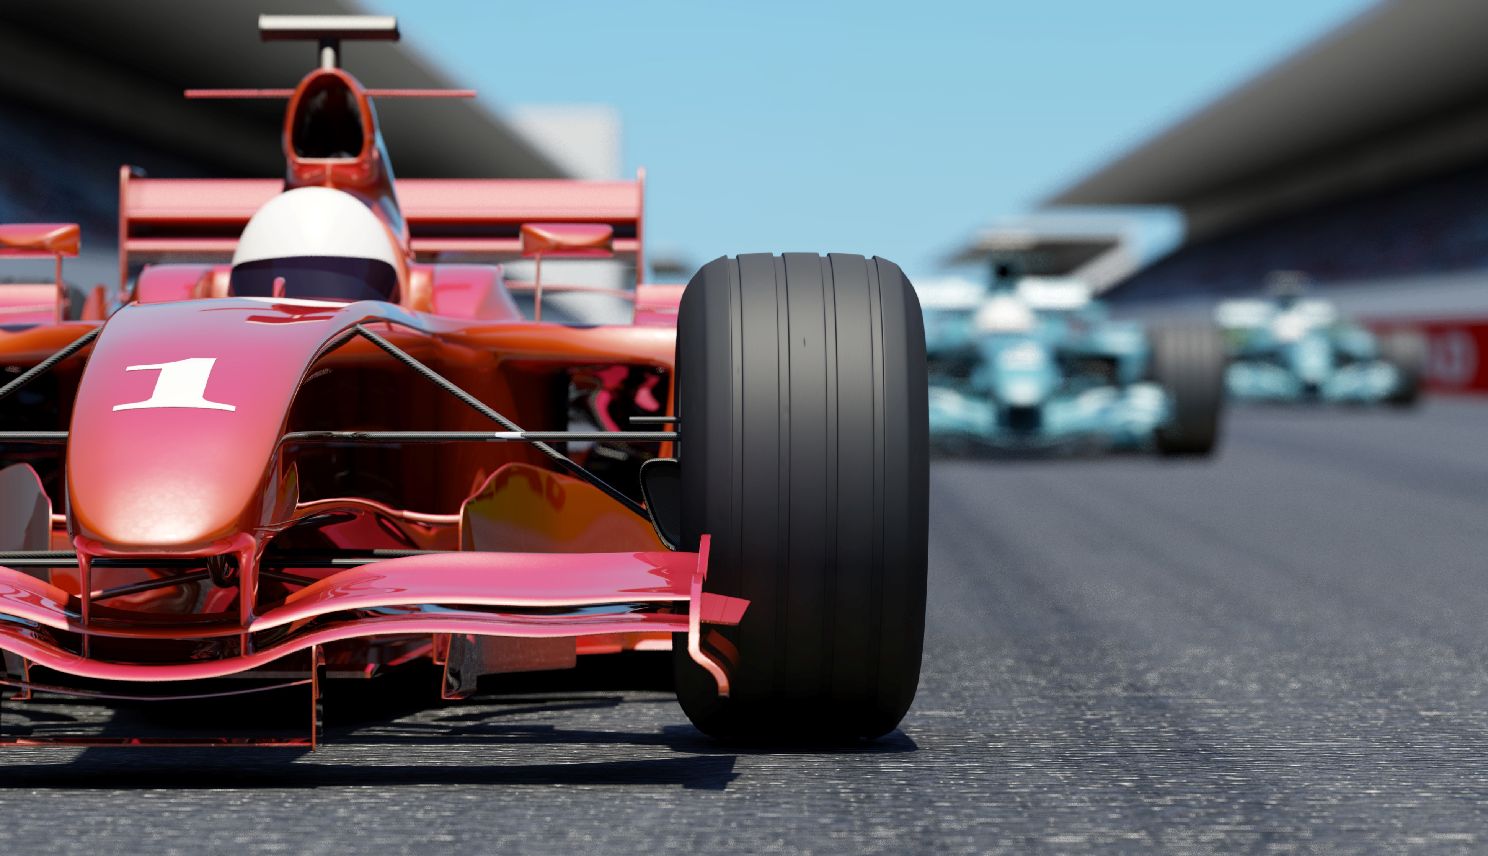
Experiment 5: Relationship between Linear and Rotational Motion

Slide 38
Setting up Rotary encoder to the mega board
Connect + pin from the rotary encoder to the 5v on the mega board
Connect GND pin from the rotary encoder to the GND on the mega board
Connect CLK pin from the rotary encoder to pin 8 on the mega board
Connect DT pin from the rotary encoder to pin 8 on the mega board
Attach a household item to the shaft of the encoder
Plug in device and upload code
Open the serial monitor and roll the object on rotary encoder
Mark on your object and rotate it until you reach a full revolution to get pulses per revolution

Slide 39
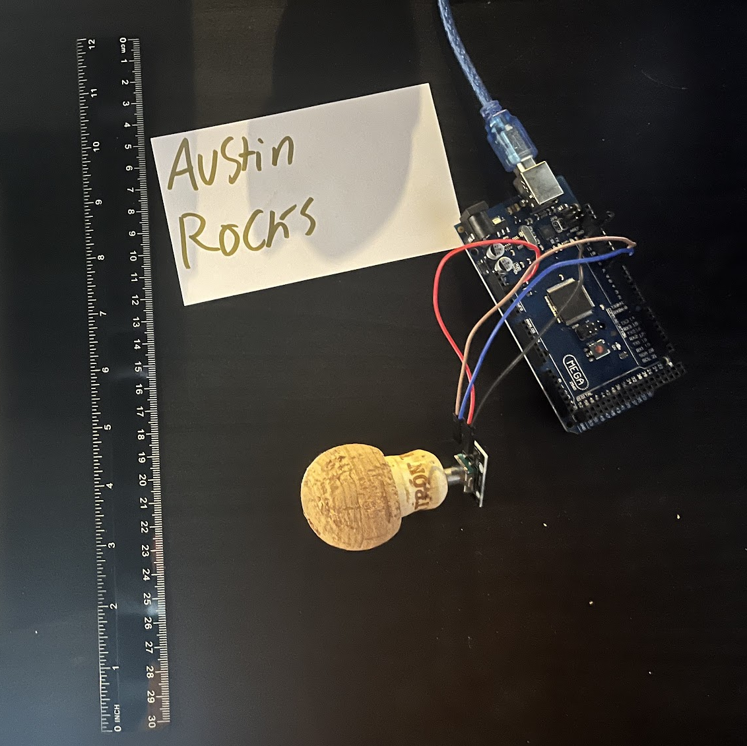
Experimental Set-up
PC running Arduino IDE
Mega 2560 Board
Rotary Encoder Module KY-040
Male to Female Wires
Object to attach onto rotary encoder (e.g. cork, bottle cap, ball)
Ruler or tape measurer

Slide 40
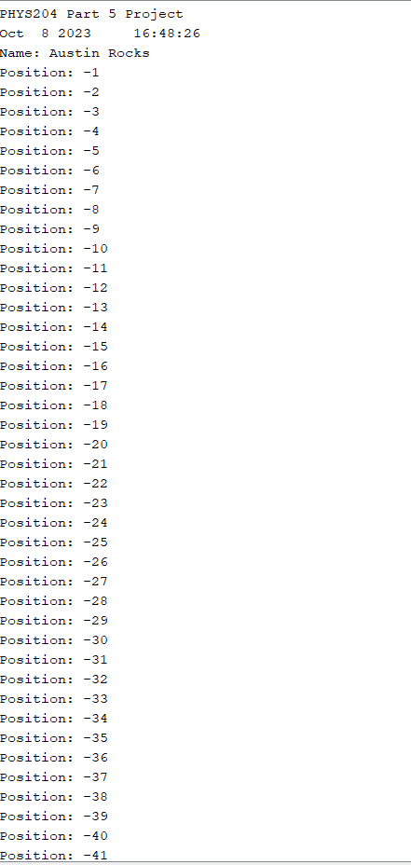
Raw Data
Raw data from Serial Monitor from Arduino IDE

Slide 41
Data Collection
Object diameter: d = 4 cm
Object radius: r = 2 cm
Number of pulses for one revolution: x = 30
Resolution = $\left(\frac{1 }{30 } \frac{Revolution}{pulses}\right)∙\left(\frac{2∙π radians}{1 Revolution}\right)=0.209 Radian per pulse$

Slide 42
Data Analysis
Trial | Number of pulses N | Encoder distance r$∙Resolution∙$ N | Measured distance with ruler | Percent difference
1 | 60 | 25.08 cm | 30 cm | 16.4%
2 | 52 | 21.736 cm | 25 cm | 27.5%
3 | 44 | 18.4 cm | 20 cm | 38.7%
4 | 33 | 13.79 cm | 15 cm | 54%
5 | 22 | 9.196 cm | 10 cm | 69.3%

Slide 43
Conclusions
The results and comment on the sources of error.
One of the major issues I had with the trials was traction on the surface. Many times, it wouldn’t roll so I would have to begin a new trial due to it not rotating consistently due to the surface.
What are some applications of this measuring technique?
Rotary encoders are used in vehicles for various applications. This includes tire speed, controlling automatic transmissions, and tracking the steering wheel position of the vehicle.
Could this measuring system be used to measure surfaces that are not flat?
It could be done on non-flat surfaces but there are a lot of issues that could arise. There could be irregularities in the surface, sensor types, and the contact mechanisms could, and more could face different issues in the experiments.

Slide 44
Experiment 5 Summary
Uploaded the code to the microcontroller with a USB cable
Opened the serial monitor and rotate the object attached on the rotary encoder.
Rotate the rotary encoder until you reach 0
Marked my object and rotated it until I reach a full revolution to find number of pulses per rotation
Calculated the distance the object of radius rolled through

Slide 45
Experiment 6: Observing the Hall Effect

Slide 46
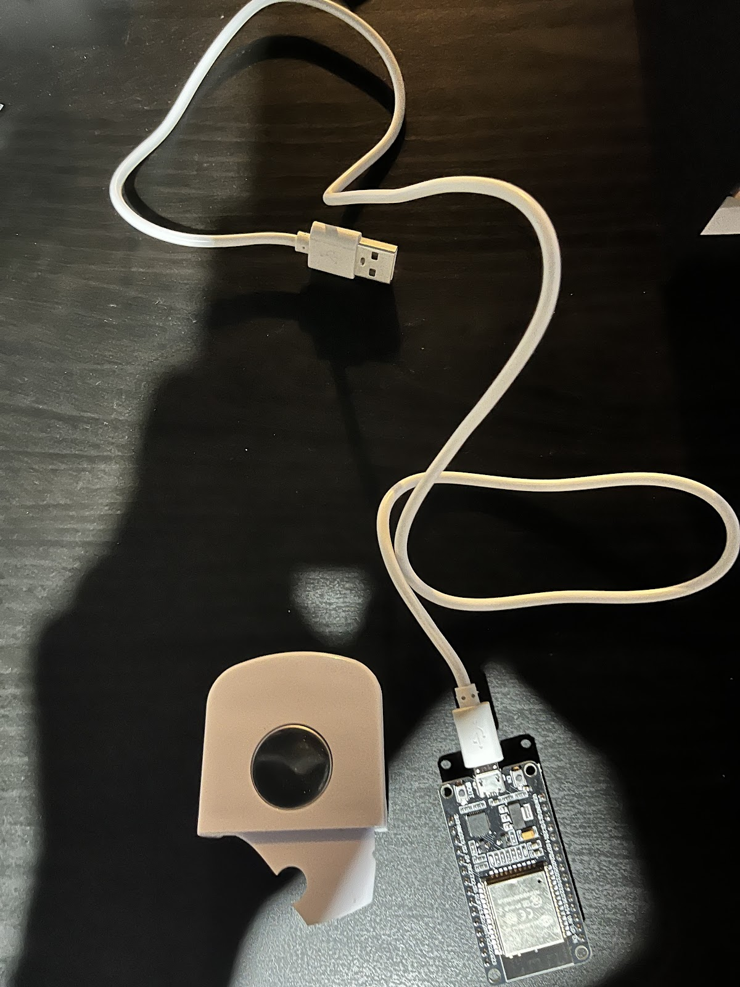
Experimental Set-up
Materials List:
ESP32 microprocessor
Micro-USB cable
Magnet

Slide 47
Setting up the ESP32 microcontroller
Plug esp32 into usb
Open preference in Arduino
Enter https://raw.githubusercontent.com/espressif/arduino-esp32/gh-pages/package_esp32_index.json into the Additional Board Manager URL
Go to tools> Boards> Boards Manager
Search EP32 by Espressif Systems
Select board and port
Upload code
Press EN to display name and turn off autoscroll

Slide 48
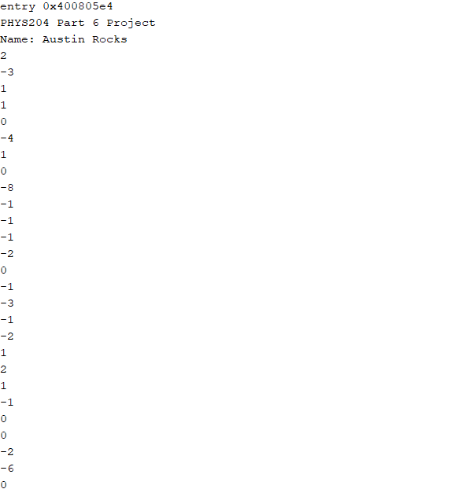
Raw Data
Serial Monitor from Arduino IDE showing raw data.
Press EN button to display name.
Unselect “Auto scroll” and scroll all the way up.

Slide 49
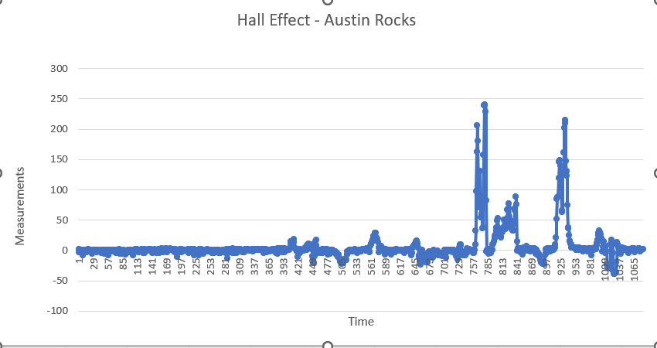
Excel Graph
Excel graph for a single trial of data plotted as a function of time.

Slide 50
Conclusions
The results and comment on the sources of error.
One of the main errors I made was not having the magnet perfectly centered as I was moving it up and down. This led the esp32 to not read properly at times. Another source of error was from the speed I moved the magnet, I tried to be as consistent as possible however I went too fast at times and to slow the other causing a broad range of measurements.
Describe how the Hall sensor works. What are some applications for the Hall effect sensor?
The Hall sensor detects if magnets are presence and magnitude of a magnetic field. You can use the Hall sensor to measure the voltage and magnetic fields when manufacturing, testing, and inspecting. A few applications you could use the Hall sensor with is sensing cam and crankshaft of a vehicle, automotive ignition systems, and detecting the wheel speed for Anti lock Braking System (ABS).

Slide 51
Challenges
Experiment 2: When I did the distance on 10 cm, the velocity was higher than the velocity at 12cm. I rechecked my math and the results from the serial monitor and I continued to get the same results.
Experiment 3: My hand got in the way during the release causing the book to not fall flat affecting the data during those trials
Experiment 4: My experiment isn’t completely accurate; It was decreasing but spiked at the end.
Experiment 5: Lack of traction on the surface caused the cork to not rotate properly at times
Experiment 6: Observed the Hall effect as a relationship between voltage and magnetic field

Slide 52
Career Skills
What skills were developed that will benefit your career?
Physics
How to calculate waves, rotation, force, and acceleration
Object-oriented programming
What competencies will help you gain the opportunities to advance your career?
Programming devices
Installing and experience with different software
Calculating different types of physics problems

