Slide 1
SEC285 Final Presentation
Austin Rocks

Slide 2
Asymmetric Key Encryption
Objective: Explore technical and administrative controls using encryption. Secure file management is implemented to mitigate risks to enterprise data assets.

Slide 3
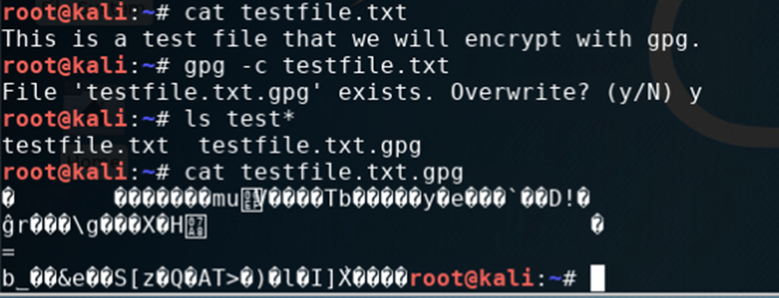
File Encryption
Content of the plaintext file
Content of the encrypted file

Slide 4
File Decryption
The encrypted file being listed by itself
The decrypting process
Both the encrypted file and the original plaintext file being listed

Slide 5
Stateful Firewall
hardened a Linux server by setting up a stateful firewall with iptables.
Project question:
What effect does the sudo iptables --policy INPUT DROP command have on the access to computing resources?
Answer: There are 0 ports open.

Slide 6
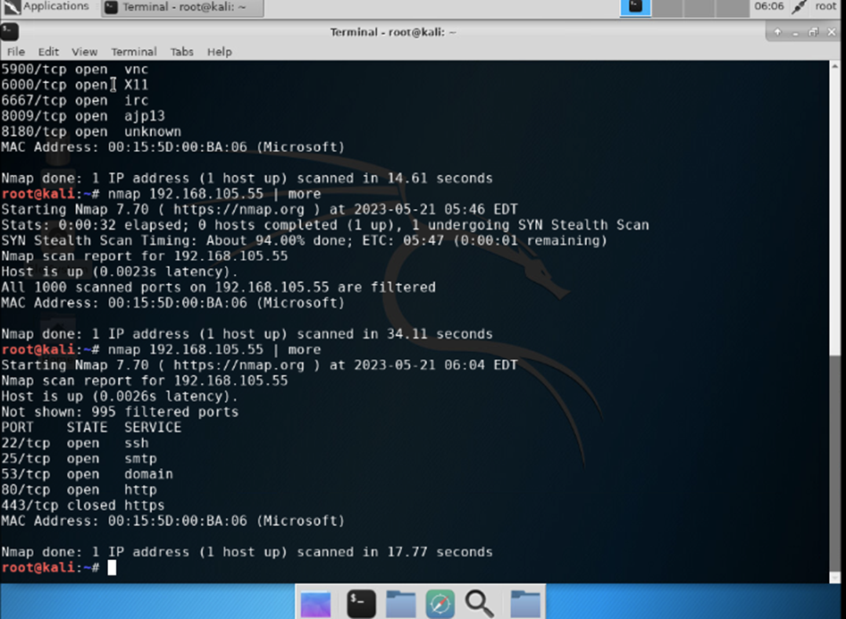
Running NMAP
Caption01 appears here

Slide 7
Creating A Security Policy
Created my own device (BYOD) security policy for ABC Corporation based on a SANS security policy template.
Original question:
ABC Corporation plans to allow their employees to use their own devices to access computing resources. However, there are no security policies that provide guidance on mitigating related risks. You are tasked to use the BYOD security policy template to complete the BYOD security policy for ABC Corporation.

Slide 8
Overview
Hackers can cost companies millions of dollars in damages if they gain access to sensitive information. They can unleash ransomware and hold the data for ransom and demand money, customer information can be sold online, or they can leak the information to the public. If it becomes public, the customers can also lose trust in the company and take their business elsewhere. Regardless of the outcome, the damage will be severe. Smartphones are used by most people, they’re so common that most kids even have them. If the kids don’t have a phone, they most likely have a tablet that they play on. As nice as these devices are, they face many threats. Brute force attacks, unsecure networks, phishing schemes, and poor cyber hygiene are a few of the threats that users face on these devices. Most users don’t understand the threats they face online which can lead to many issues. Ensuring your employees are knowledgeable on the threats and receive proper training on how to prevent and recognize potential threats are essential, unless you want to lose millions of dollars in damages.

Slide 9
Purpose
With proper training, employees can learn about proper password practice, connecting to networks, and how to identify phishing attacks. This can help companies from dealing with the massive costs that come from hackers gaining access to their system and network. If employees understand the different types of attacks and how they happen, then they should be less likely to fall for the attacks. If they recognize a phishing attack, the employees could notify someone to lower the risks of someone else falling for it. Employees passwords are another great risk, if they receive proper information about password security, they can lower the risks of brute force attacks. If a hacker does gain access, the sooner they know the better. If a hacker is detected the blue team can respond immediately and cut off the hacker from gaining access to sensitive information immediately. However, if the hacker remains undetected then they can gather all the data they want and use it against the company as ransom or they could sell the information online for profits. Most breaches cost companies millions of dollars so ensuring employees understand the threats and how to notice them are essential.

Slide 10
Scope
All devices that’re used in the network will be impacted by this policy. Cyberattacks are occurring more often and the severity is increasing. Hackers are adapting daily and it’s not going to end anytime soon. Company devices are the only devices that’re allowed on the network, personal devices may be compromised and can lead to severe damages for the company.
Company Devices:
Cell phones, laptops, and tablets that are issued to the employee by the company to do their work on. The use of company devices outside of work for personal reasons is prohibited. Nonemployees are not aloud to use the company devices, no exceptions. If you’re working from home, you must remote in to work.
Appropriate use:
Searching online for information regarding work
Ensuring network is secure before connecting to outside network
Work assignments
Inappropriate use:
Downloading anything not related to work on company device
Using for personal use
Letting others use company devices or user information
Visiting inappropriate, malicious, or sensitive information for personal use

Slide 11
Scope pt.2
Appropriate use:
If you’re granted permission, you may use the devices on the network only for the purposes you received permission for. The devices that received proper permission from the InfoSec team will be monitored to ensure security of the system and network.
Searching the internet on breaks
Communicating with others via texting or calling on breaks
Turning devices off or on silent when working
Studying for certifications or college courses
Learning new skills or information to aid your productivity and efficiency
Personal Devices:
Personal devices can be a personal smartphone, tablet, or laptop. Employees must agree to and sign a Personal Device Usage Agreement before they’re able to use their devices. The company has the right to install an MDM and has the right to erase all information from the device if it’s been compromised or stolen
Cell Phones
Laptops
Tablets
Bluetooth and network access
Restrictions
You’re prohibited from:
Taking pictures or videos of confidential information
Visit inappropriate websites, and play games during work hours
Plugging any personal devices into company devices
Downloading confidential information
Speaking about confidential information with anyone
Using removable storage such as a flash drive
Bluetooth and network access

Slide 12
Policy
All BYOD devices are subject to security assessments prior to approval from security department. Any employee that wishes to get their personal devices approved must provide valid reasons on why they want or need to use the devices at work. If approved these devices will have to meet certain requirements before they can be used.
Personal Devices:
For personal devices to be compliant they must have:
Up-to-date antivirus and OS System patches
Firewalls
Device Remediation:
All employees are responsible for ensuring these requirements are met before they can seek approval to use their devices in the workplace. If the device fails the assessments, the employee will be provided with an explanation on why it failed and how to fix the issue. If the employee needs assistance in fixing the issue, they can seek assistance from the help desk.
Company Devices:
All information stored on or transmitted through the company device may be accessed anytime with or without prior knowledge

Slide 13
Policy Compliance
The InfoSec team will monitor the employees using multiple methods to prevent violations to this policy. Some of the methods will be video monitoring, walk-throughs, anonymous tips, fake phishing emails, web monitoring, and intrusion detection tools.
Disciplinary actions:
If an employee is found breaking any rule in this policy, they can face one of the following disciplinary actions:
Verbal warning
Written warning
Write up
Attend training courses
Termination
These disciplinary actions will depend on the policy that was broken and how severely the employee broke the policy. Small mistakes will be taken seriously but they won’t be terminated. There are many risks that the employees face so they will receive proper trainings to learn from the mistake to try and prevent it from happening again. If they continue to make the same mistakes, then the disciplinary actions will gradually increase.

Slide 14
Policy Compliance pt.2
Zero Tolerance Policy:
Any Employee will be immediately terminated for the following:
Sharing user or confidential information
Plugging personal devices into company devices before being approved
Letting others use company devices
Downloading or visiting inappropriate websites or pictures

Slide 15
Related Standards, Policies, and Processes:
PCI-DSS- PCI-DSS is a compliance that is related to securing users card information. It helps builds a strong network and create access-control restrictions, and constantly monitor for potential threats.
CIO-IT Security-12-67 policy- This policy allows employees to use their devices but allows the company to secure the data and help eliminate breaches if a device is compromised.
Health Insurance Portability and Accountability Act of 1996 (HIPAA)- HIPPA can be linked to this policy because it’s related to sensitive information about customers .
NIST SP 800-124 Rev. 2- NIST published the standard on how companies should manage and secure mobile devices against the threats that these devices face.

Slide 16
Multifactor Authentication (MFA)
Objective
Implement multifactor authentication (MFA) by adding a time-based one-time password (OTP) to the authentication process.

Slide 17
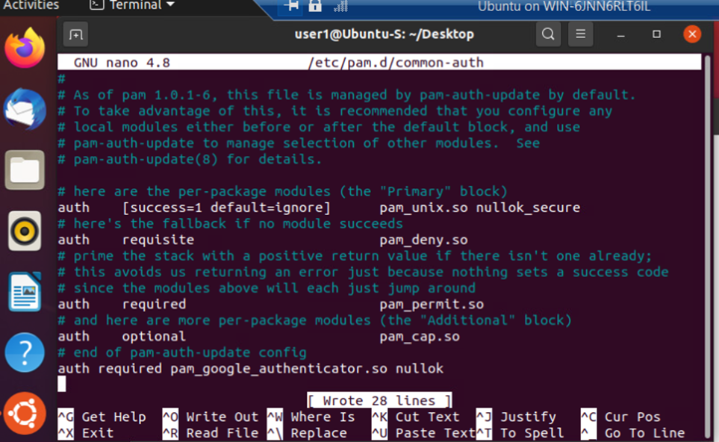
Common-auth Configuration File
The entry that indicates the use of the Google Authenticator module

Slide 18
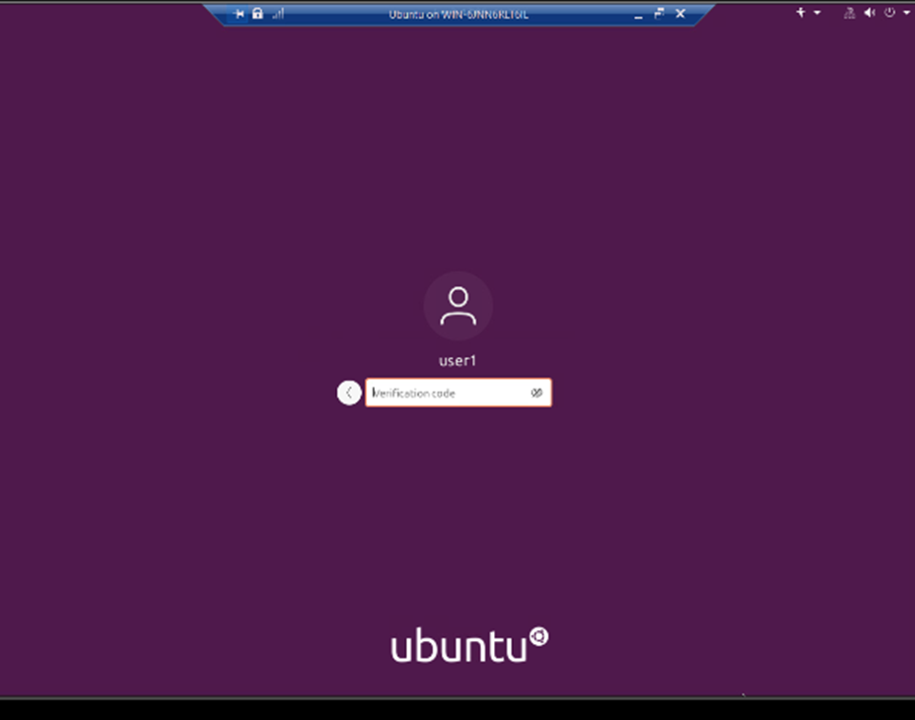
MFA Logon Screen

Slide 19
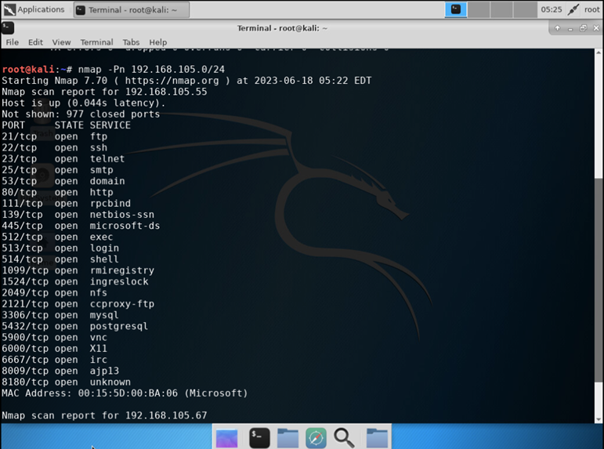
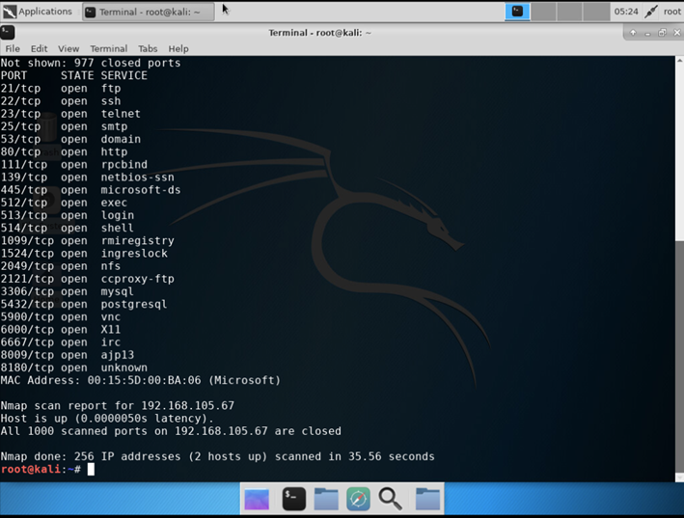
Nmap
The scan result showing both the Kali and Linux Server VMs.

Slide 20
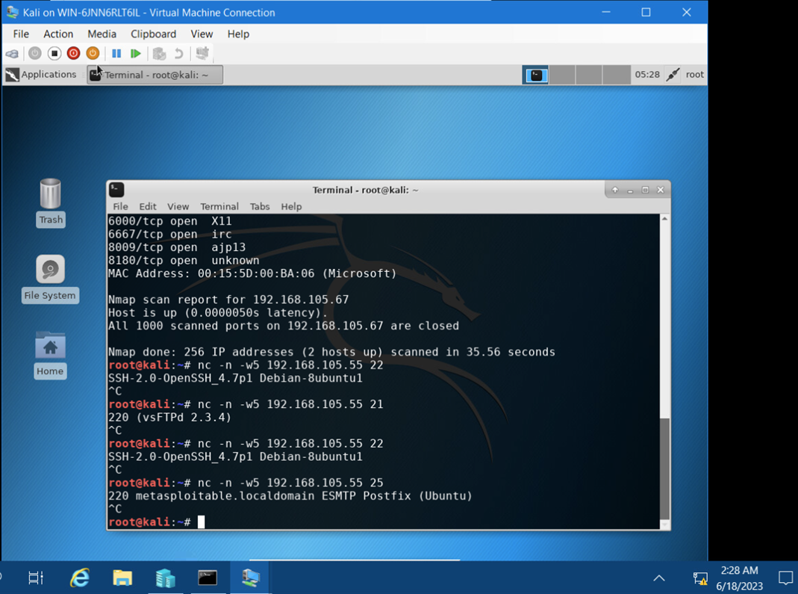
NetCat
The result showing both the Kali and Linux Server VMs.

Slide 21
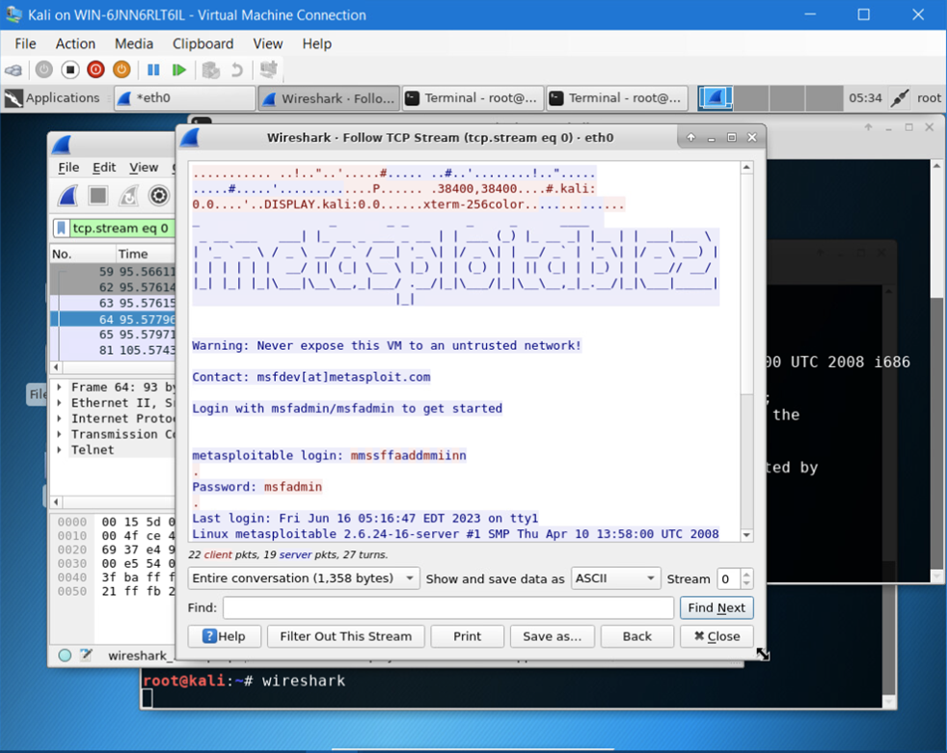
Wireshark
Wireshark—Follow TCP Steam window showing the Telnet username and password.

Slide 22
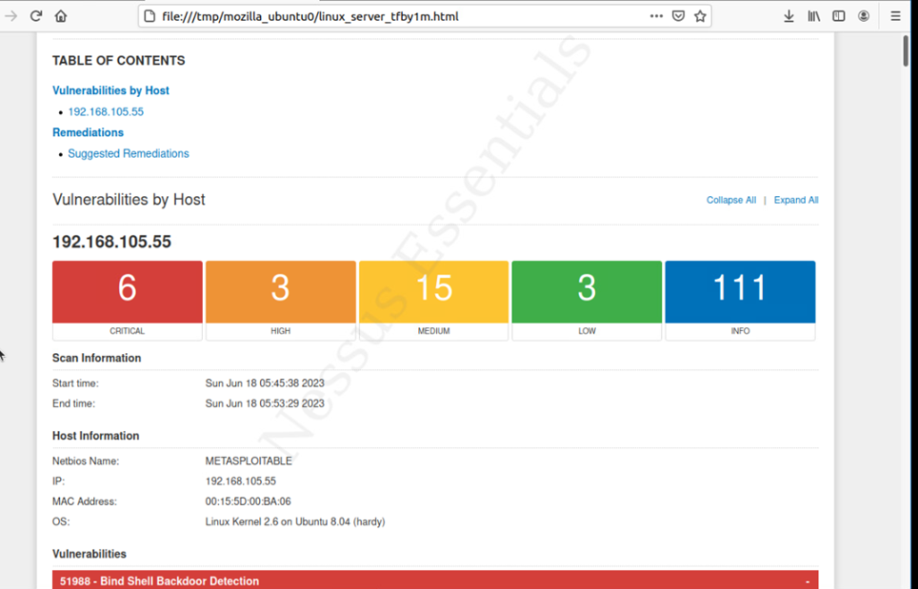
Nessus
High-level view of the Nessus vulnerability scan report (showing categories of vulnerability in different colors).

Slide 23
Career skills learned
Deeper knowledge and experience with information security
Experience with creating a security policy
Better understanding of how to work create multi authentication to the authentication process

Slide 24
Challenges
Creating the security policy was the most difficult portion of the projects during the session. It took many hours of researching into creating actual policies to gain a better understanding of how they’re created.

Slide 25
Conclusion
I learned many things this semester that will help me greatly when it comes to future learnings and future work-related tasks.
Creating a security policy gave me hands on experience creating my own policy and helped me strengthen many other skills.

Slide 26
References:
Project guide
Course readings
CompTIA Security + certification study guide

