Slide 1
Netw211 Final Course Project
Austin Rocks

Slide 2
Module 2 Virtual Machine (VM) Instances
Explore the Azure virtual machine (VM) service that provides secure and resizable compute capacity in the cloud.
Tasks:
Deploy a VM in Azure
Connect to the VM
Delete the VM

Slide 3
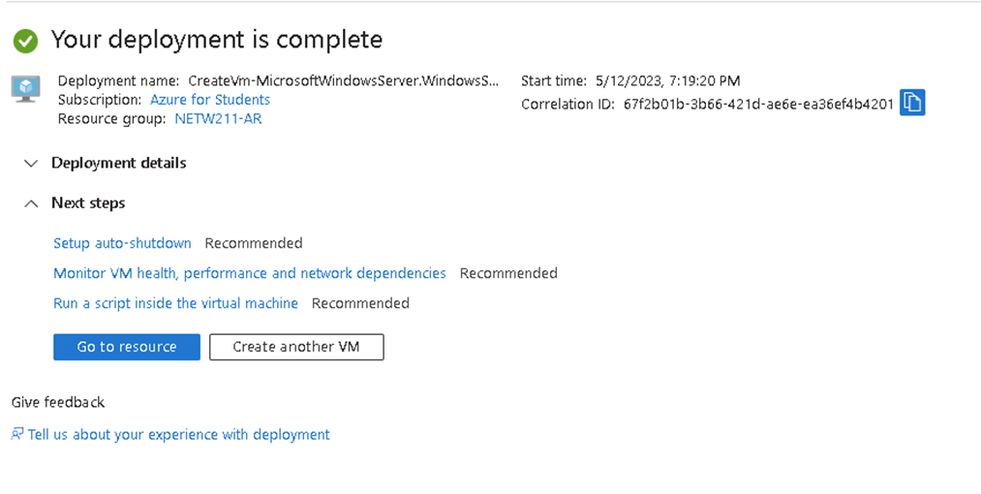
Deploying a VM in Azure
In Azure
click show portal menu
Hover over Virtual machines
Click create
Fill in required fields
Review + create
Create
Go to resource
NETW211VM page with information such as the resource group name, subscription, public IP address, etc.

Slide 4
Connecting to the VM
In Azure
On the NETW211VM page, click Connect and then RDP on the drop-down menu
Download RDP File, connect
Enter Admin Information
Click Restore down by going through server manager > dashboard window
PROPERTIES for NETW211VM page, with the computer name, operating system version, hardware information, etc.

Slide 5
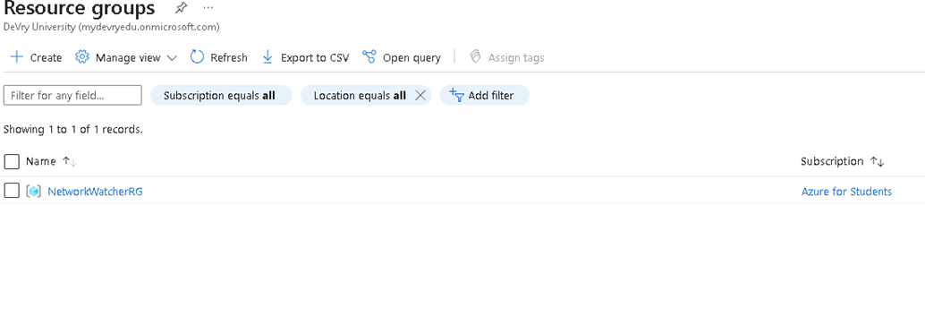
Deleting the VM
Disconnect from VM
On the NETW211VM Connect page, click NETW211VM
Click delete
Click home
Delete resource group
Resource groups page, with the Subscription == all selection, but without the NETW211-XX (Your Initials) resource group listed.

Slide 6
Azure VNet and Subnets
Module Objectives:
Explore the Azure Virtual Network (VNet) service. It allows customers to
provision a logically isolated section of the Azure cloud and launch resources into a virtual
network
Tasks:
Creating a VNet with Two Subnets
• Deploying VMs into Subnets
• Verifying Connectivity between VMs

Slide 7
Creating a VNet with Two Subnets
1. With a /24 network prefix, how many usable IPv4 host addresses are there? [hint: you learned this in NETW191]
Answer:254
2. Given the answer above, why is the number of available IP addresses for Subnet0 (10.0.0.0/24) or Subnet1 (10.0.1.0/24) shown as 251? [hint: where did the missing addresses go?]
Answer: The missing addresses are reserved for Network ID, DNS IP address, Router IP address, reserved for future uses, and Broadcast IP address

Slide 8
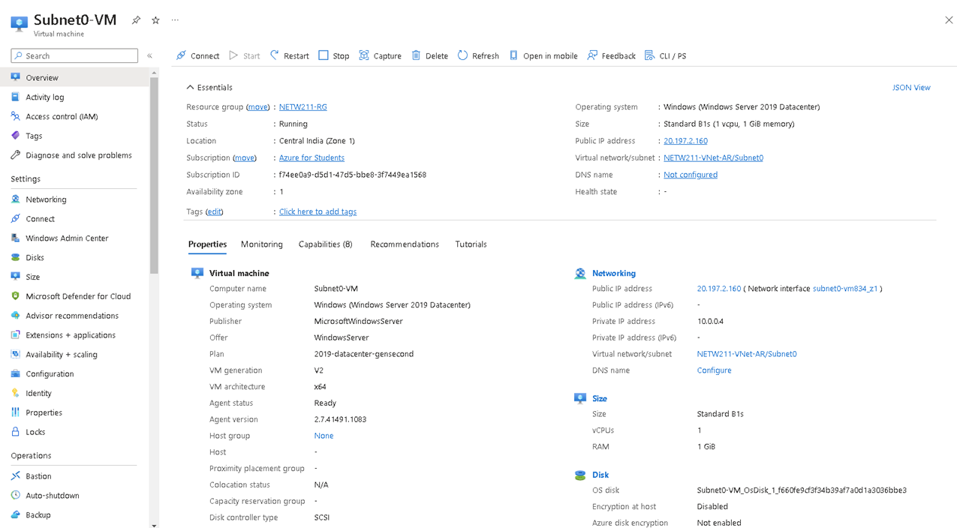
Deploying VMs into Subnets
Create VM
Fill in required information
Select the subnet
Create
Repeat previous steps to launch a second VM into Subnet1
Subnet 0

Slide 9
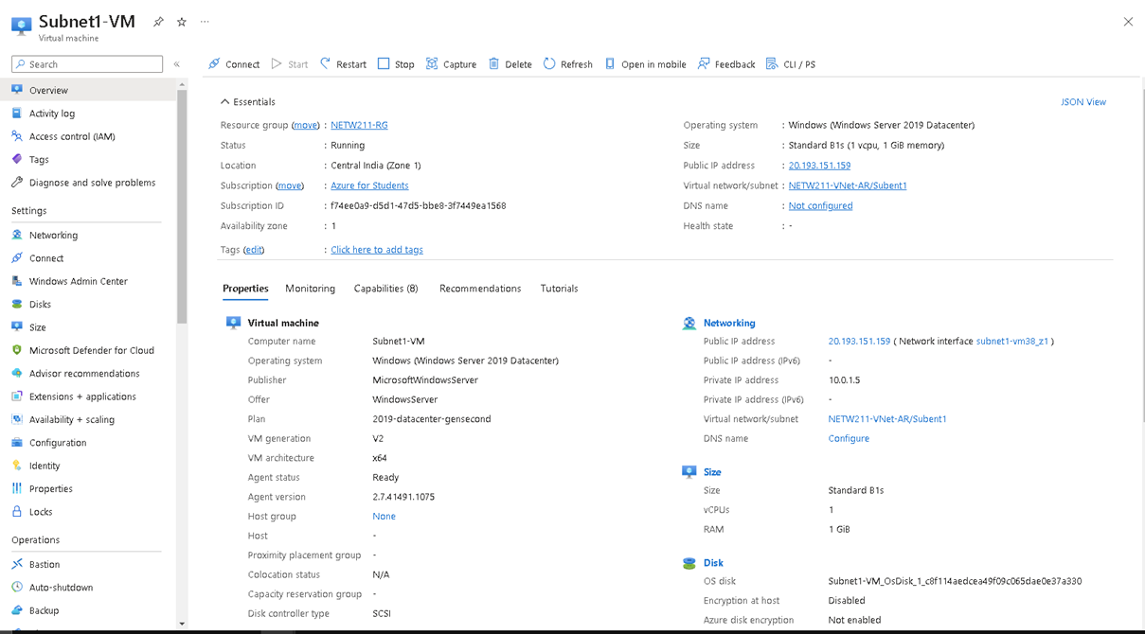
Deploying VMs into Subnets cont’d
Subnet 1

Slide 10
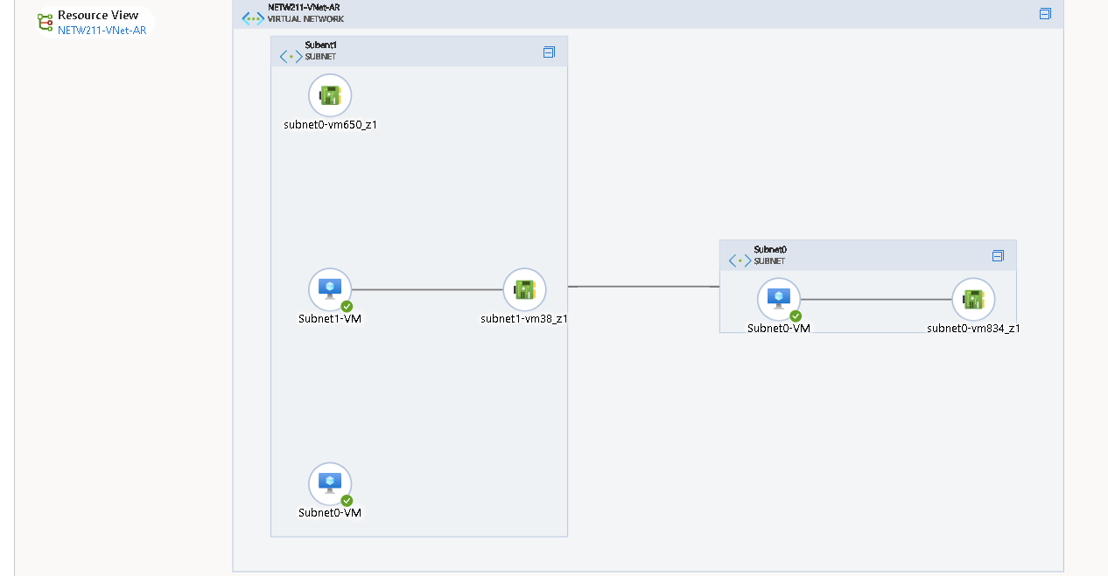
Deploying VMs into Subnets cont’d
topology diagram of your VNet with two subnets (Subnet0 and Subnet1) and one VM in each subnet (Subnet0-VM and Subnet1-VM).

Slide 11
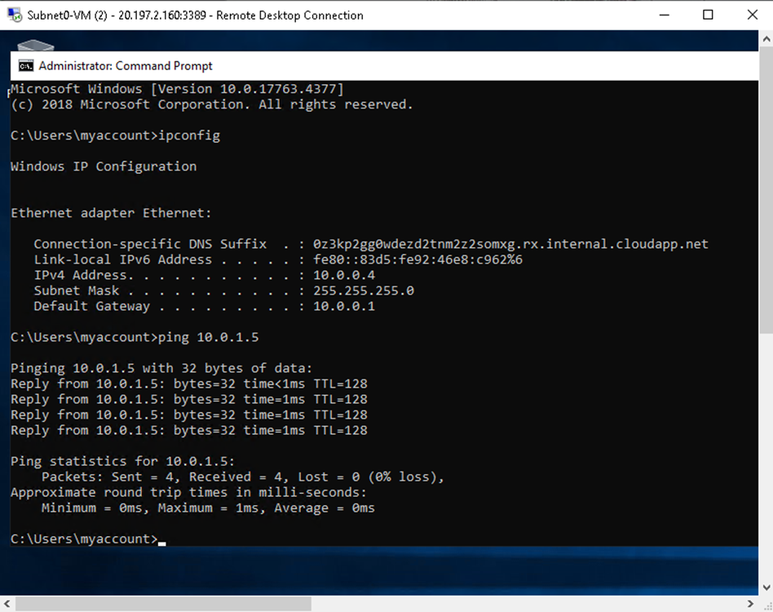
Verifying Connectivity between VMs
Connect and Download RDP File
Open Command Prompt
Type ipconfig to view Subnet0 IP address
Ping 10.0.1.5

Slide 12
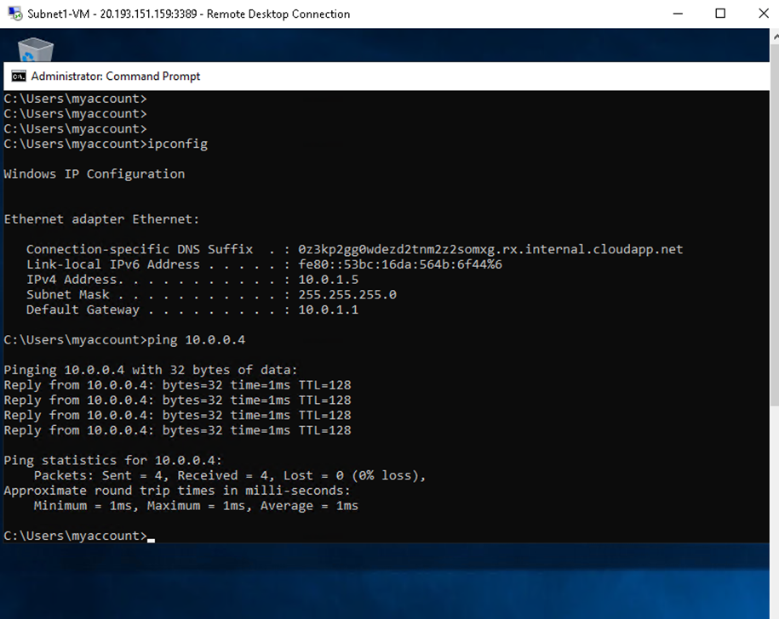
Verifying Connectivity between VMs cont’d
Connect and Download RDP File
Open Command Prompt
Type ipconfig to view Subnet1 IP address
Ping 10.0.0.4

Slide 13
Azure VM Security
Objectives:
Explore how to securely connect to an Azure VM via SSH, and how to
control inbound and outbound traffic by configuring a network security group (NSG).
Tasks:
Launching a VM
• Connecting to the VM via SSH
• Configuring an NSG

Slide 14
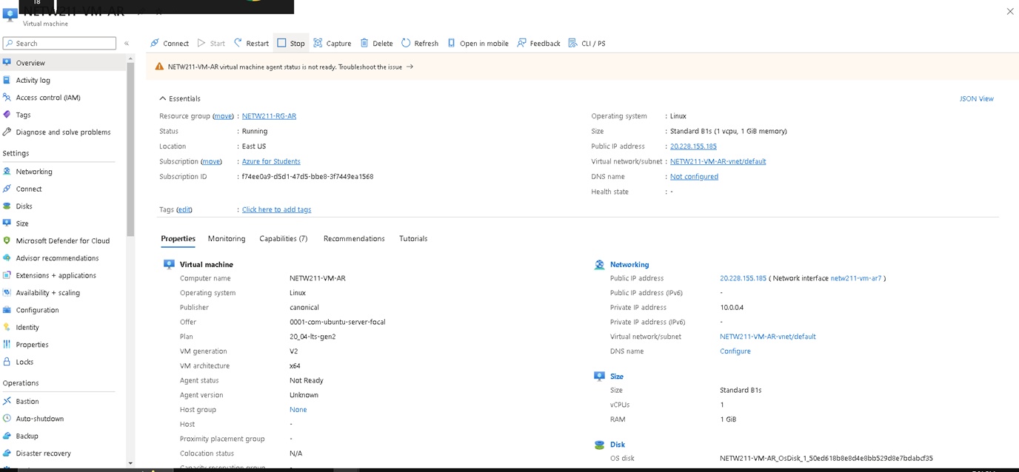
Launching a VM
click show portal menu
Hover over Virtual machines
Click create
Fill in required fields
Review + create
Create
Go to resource

Slide 15
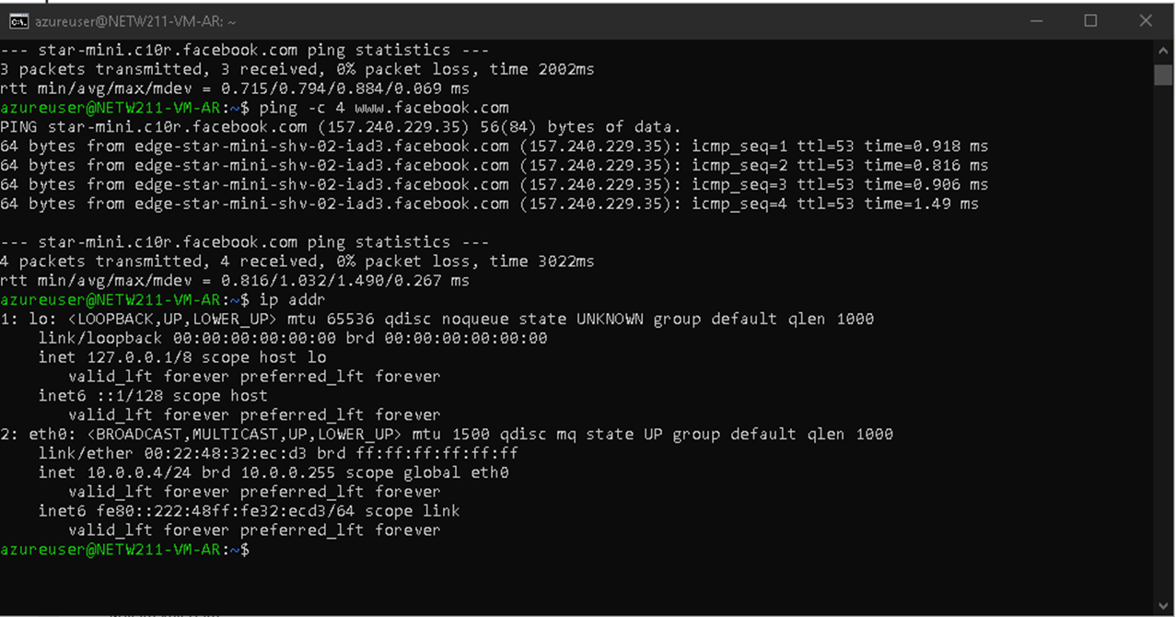
Connecting to the VM via SSH
On the initial page, connect > SSH in drop down
Paste the ssh -i <private key path> azureuser@x.x.x.x command into the command prompt
window on your local computer (screenshot below). Replace <private key path> with the key
file name: NETW211-VM-XX (Your Initials)_key.pem. Answer Yes to the security warning.
the azureuser@NETW211-VM-Your Initials window showing the IPv4 address of the VM in the Azure cloud.

Slide 16
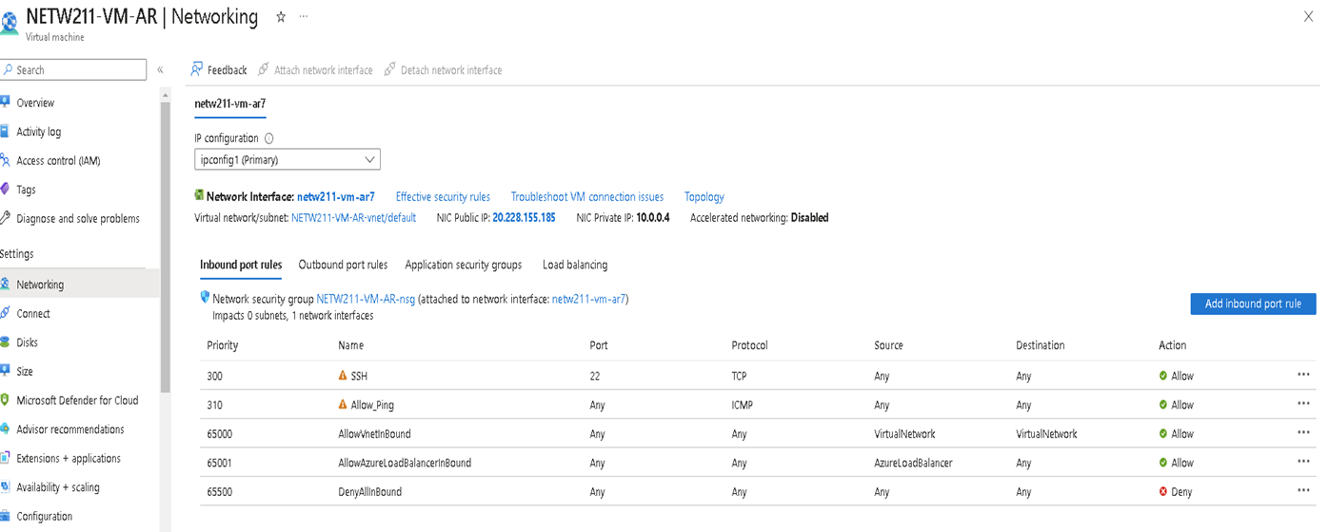
Configuring an NSG
Click networking
Type cmd in search field
Ping the Public IP
Add inbound port rule
ICMP under protocol and entered Allow_ping, add

Slide 17
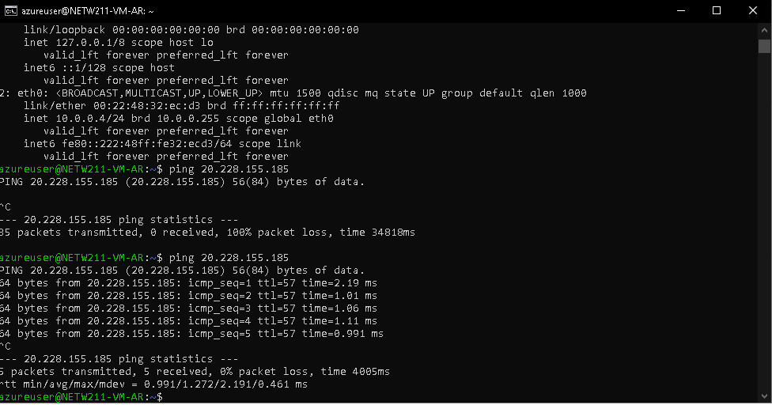
Configuring an NSG cont’d
Run ping again

Slide 18
Cloud Storage
Objectives
Explore Azure’s Blob storage, It’s an object storage used to store and protect data for use cases such as mobile applications, websites, backups, IoT devices, and bigdata analytics.
Tasks:
Creating a Storage Account and Container
• Uploading and Accessing a File
• Creating Blob Snapshots

Slide 19
Creating a Storage Account and Container
Azure Blob storage offers multiple types of resources: a storage account, a container in the storage account, and a blob in a container.
Steps:
Log in Azure, click storage accounts, and create
Fill in required information
Create and deploy
Go to resource
Click containers, created netw211container8269

Slide 20
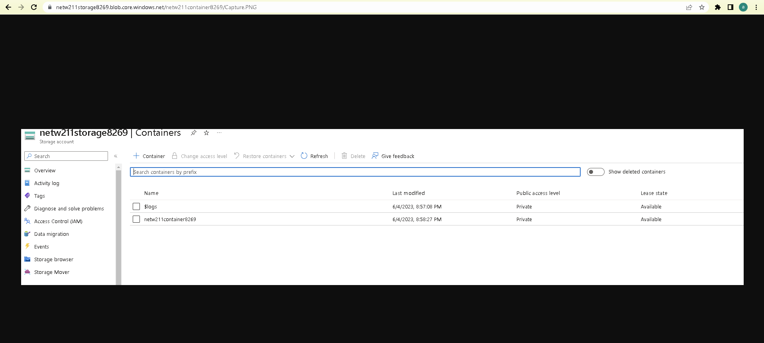
Uploading and Accessing a File
Go back to netw211container8269
Take a screenshot, save as .jog
Click upload to create an image to container

Slide 21
Question
What does the access tier setting do? What are the Azure blob storage access tiers?
Answer:
The access tier setting allows you access to different access tiers so you can store blob data in a most effective way.
Hot tier- Online tier that optimized for storing data that is accessed often
Cool tier – Online tier that stores data that’s not used frequently, stored for minimum 30 days
Cold tier- Online tier that stores data that’s not used frequently, stored for minimum 90 days
Archive tier- offline tier optimized for data that’s rarely accessed.

Slide 22
Creating Blob Snapshots
A blob snapshot is a read-only copy of a blob that's taken at a specific point in time by a user or an application.
Open File Explorer, select new text document ca;;ed NETW211FILE
Typed “This is the original version –AR”
I then uploaded the file, once completed, I took a snapshot

Slide 23
Enabling Blob Versioning
Edited file content to “This is the modified version –AR”
Saved the changes
Clicked on overview, copied the link the clipboard and pasted the blob URL into a browser.

Slide 24
Cloud Monitoring
Objectives
Explored Azure Monitor, a service used to monitor Azure resources
Tasks:
Setting up an Action group and Notifications
Setting up Alert Rules
Testing Alerts

Slide 25
Setting up an Action Group and Notifications
Searched and clicked on subscriptions in Azure
Selected Azure for Students & Resource providers
Registered microsoft.insights
Went to Monitor and clicked alerts > action groups > create
Created group action page and filled out required information
Clicked notifications, selected Email/SMS message/Push/Voice
Checked email, typed in email, clicked okay
Review + create

Slide 26
Setting up Alert Rules
Alert rules window showing the VM-Deallocate and VM-Restart rules

Slide 27
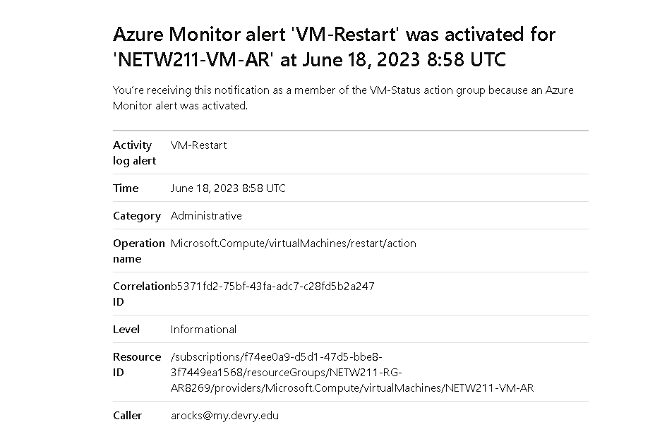
Testing Alerts
The ‘VM-Restart’ was activated email message with the date and time of the alert.

Slide 28
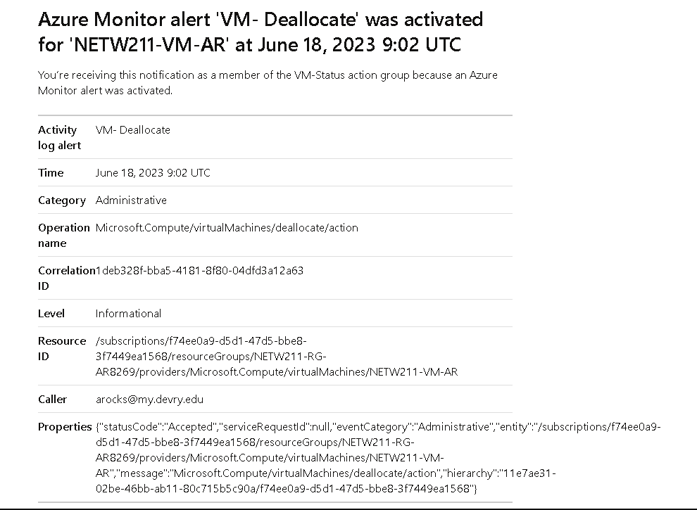
Testing Alerts cont’d
The ‘VM-Deallocate’ was activated email message with the date and time of the alert

Slide 29
Challenges
With there being a lot of information that I needed to learn, it took extra time of studying to fully grasp the assignments and develop a better understanding of the steps I was doing and why I was doing them.

Slide 30
Career skills
I learned how to set up virtual machines, create blob snapshots, and more about monitoring.
I gained many cloud security skills that will help me in my career path.
Spending plenty of time with virtual machines helped me gain more confidence in creating VM’s and subnetting them.

Slide 31
Conclusion
This class has helped me gain valuable skills to help me better prepare for my future career path.
The hands-on experience gave me a much better understanding of working with VM’s and how to perform many different tasks.

Slide 32
References
Hot, Cool, and Archive access tiers for blob data, https://docs.microsoft.com/en-us/azure/storage/blobs/access-tiers-overview
Azure Blob Storage Access Tiers, https://devry.percipio.com/courses/c7ef0333-8560-403f-a004-9c5c843866b0/videos/2658bbe6-ee97-438b-a376-fbb079c3b3a0
https://learn.microsoft.com/en-us/azure/storage/blobs/access-tiers-overview?tabs=azure-portal
IP Subnet Calculator, https://www.calculator.net/ip-subnet-calculator.html
2. Azure Virtual Network frequently asked questions, https://docs.microsoft.com/en-us/azure/virtual-network/virtual-networks-faq
3. https://convertermaniacs.com/ipv4-blocks-to-ip-addresses/how-many-ip-addresses-in-a-/24-block.html#:~:text=Therefore%2C%20the%20total%20number%20of%20useable%20IPs%20in,Broadcast%20IP%20address%20%3D%20254%20usable%20IP%20addresses
4. https://asmed.com/microsoft-azure-vnet-vm-subnet-and-security-tutorial/#:~:text=As%20you%20see%20when%20you%20create%20above%20subnet,%E2%80%93%2010.0.3.255%20%28251%20%2B%205%20Azure%20reserved%20addresses%29

